Slide 1
UMD DATA605 - Big Data Systems Cloud Computing
GP Saggese
gsaggese@umd.edu
with thanks to Alan Sussman,
Amol Deshpande

Slide 2
Cloud Computing
Computing as a “service” rather than a “product”
Everything happens in the “cloud”: both storage and computing
Edge devices (e.g., phones, laptops, tablets) simply interact with the cloud
Advantages
Device agnostic – can seamlessly move from one device to other
On demand
Efficiency / scalability: programming frameworks allow easy scalability (relatively speaking)
Increasing need to handle “Big Data”
Reliability
Cost: “pay-as-you-go” allows renting computing resources as needed
Much cheaper than building your own systems
Computing becomes a commodity

Slide 3
Building vs Renting
Building infrastructure vs cloud computing
Building infrastructure
Buy hardware (network, storage)
Update hardware when it becomes obsolete
Cost of owning hardware (e.g., data center)
How do you estimate the size of your hardware?
Difficult to estimate future demands
Administering
Installing, tweaking, maintaining software stack
Building infrastructure requires time and capital investments
Especially at the beginning when there aren’t revenues
Cloud computing
Pay for what you use (low capital investment)
Get the systems with a click
No need to estimate a multi-year resource plan
Pick machines that suit your application and data requirements

Slide 4
Cloud Computing
Basic ideas of cloud computing have been around for a long time (going back to 1960’s)
Mainframes + thin clients (more by necessity)
Grid computing a few year ago
Peer-to-peer architecture
Client-server models (Web 1.0 and 2.0)
Cloud computing
But it finally works
Why now?
A convergence of several key technologies over the last few years
E.g., OS virtualization, large data centers, decreasing hardware costs, big data frameworks
Does it really?
Yes, but still many growing pains

Slide 5
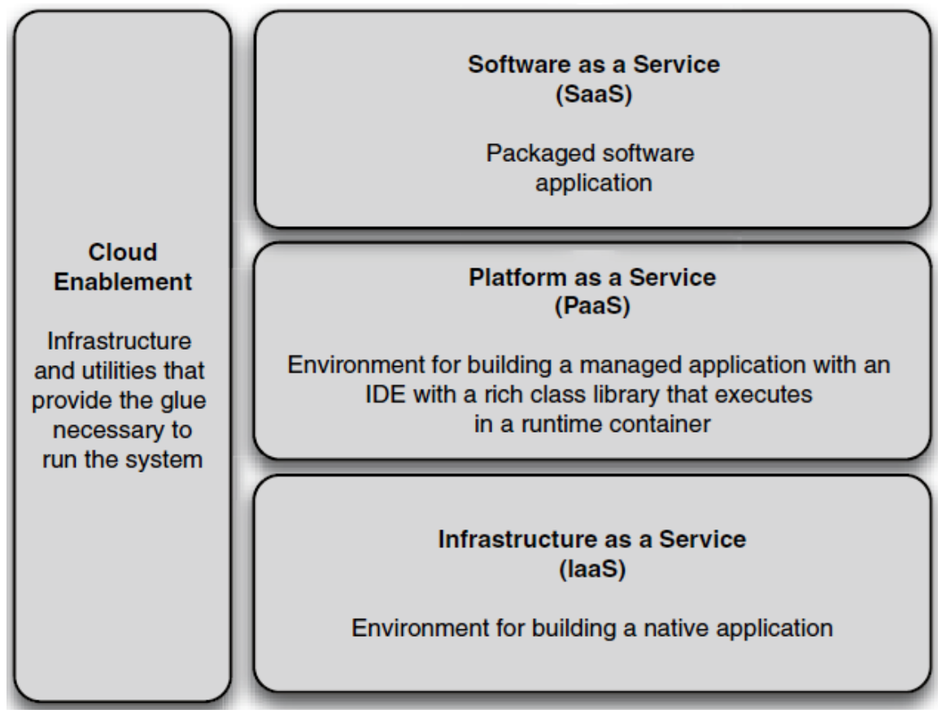
X-as-a-Service
Infrastructure as a service (IaaS)
E.g., AWS EC2
You install and maintain OS and applications
Platform as a service (PaaS)
Cloud provides OS and programming languages
E.g., Google App engine, Hadoop
Software as a service (SaaS)
Cloud provides the application
E.g., Dropbox
XaaS
Storage as a service
Marketing as a service

Slide 6
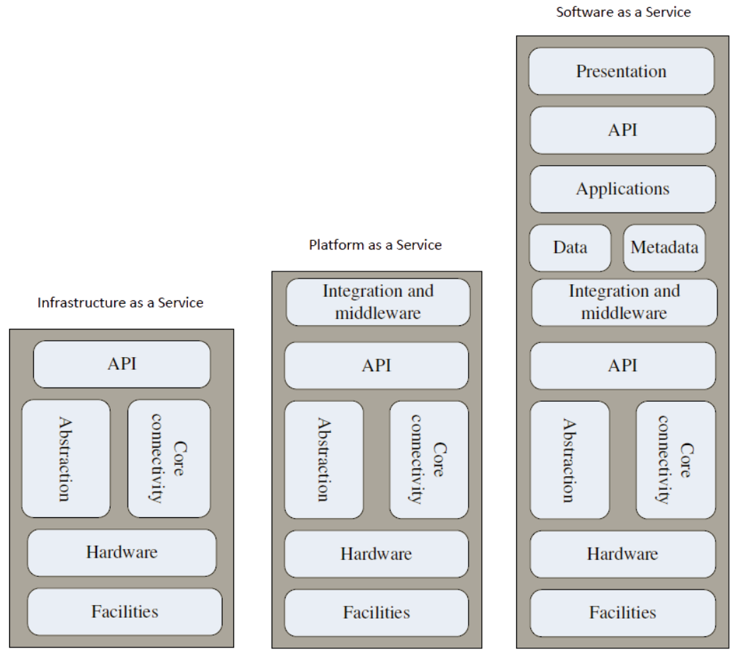
X-as-a-Service
Assembling your own software stack can be messy and require work
You can get a software stack with pre-installed OS, libraries, application software
E.g., pre-built Hadoop images
Virtualization solution
E.g., VMware or Docker
The software stack comes as a large file with the image of the system
Pre-built images for Hadoop
E.g., Hortonworks, Cloudera

Slide 7
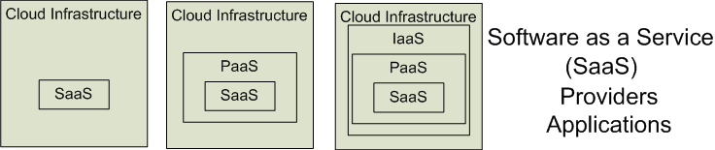

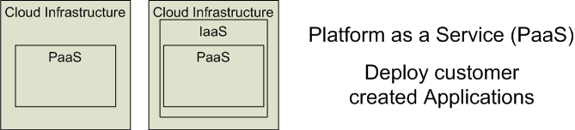
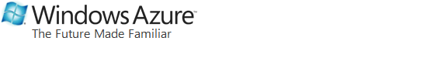
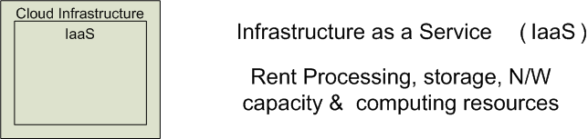
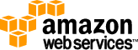

Cloud Service Models
Software as a Service (SaaS)
Platform as a Service (PaaS)
Infrastructure as a Service (IaaS)
SalesForce CRM
LotusLive
Google App Engine
From Effectively and Securely Using the Cloud Computing Paradigm by Peter Mell & Tim Grance, NIST
Adopted from: Effectively and Securely Using the Cloud Computing Paradigm by peter Mell, Tim Grance
Notes:
IaaSdelivers computer infrastructure, typically a platform virtualization environment, as a service. Rather than purchasing servers, software, data center space or network equipment, clients instead buy those resources as a fully outsourced service.
PaaSdeliver a computing platform where the developers can develop their own applications.
SaaSis a model of software deployment where the software applications are provided to the customers as a service.

Slide 8
Different Cloud Computing Layers‏
MS Live/ExchangeLabs, IBM,
Google Apps; Salesforce.com
Quicken Online, Zoho, Cisco
Application Service
(SaaS)‏
Google App Engine, Mosso,
Force.com, Engine Yard,
Facebook, Heroku, AWS
Application Platform
Server Platform
3Tera, EC2, SliceHost,
GoGrid, RightScale, Linode
Storage Platform
Amazon S3, Dell, Apple, ...
From Dr. Mehmet Gunes, U. Nevada Reno

Slide 9
Cloud Computing Service Layers
Services
Description
Services
Services – Complete business services such as PayPal, OpenID, OAuth, Google Maps, Alexa
Application
Focused
Application
Application – Cloud based software that eliminates the need for local installation such as Google Apps, Microsoft Online
Development
Development – Software development platforms used to build custom cloud based applications (PAAS & SAAS) such as SalesForce
Platform
Platform – Cloud based platforms, typically provided using virtualization, such as Amazon ECC, Sun Grid
Infrastructure
Focused
Storage
Storage – Data storage or cloud based NAS such as CTERA, iDisk, CloudNAS
Hosting
Hosting – Physical data centers such as those run by IBM, HP, NaviSite, etc.
From Dr. Mehmet Gunes, U. Nevada Reno

Slide 10
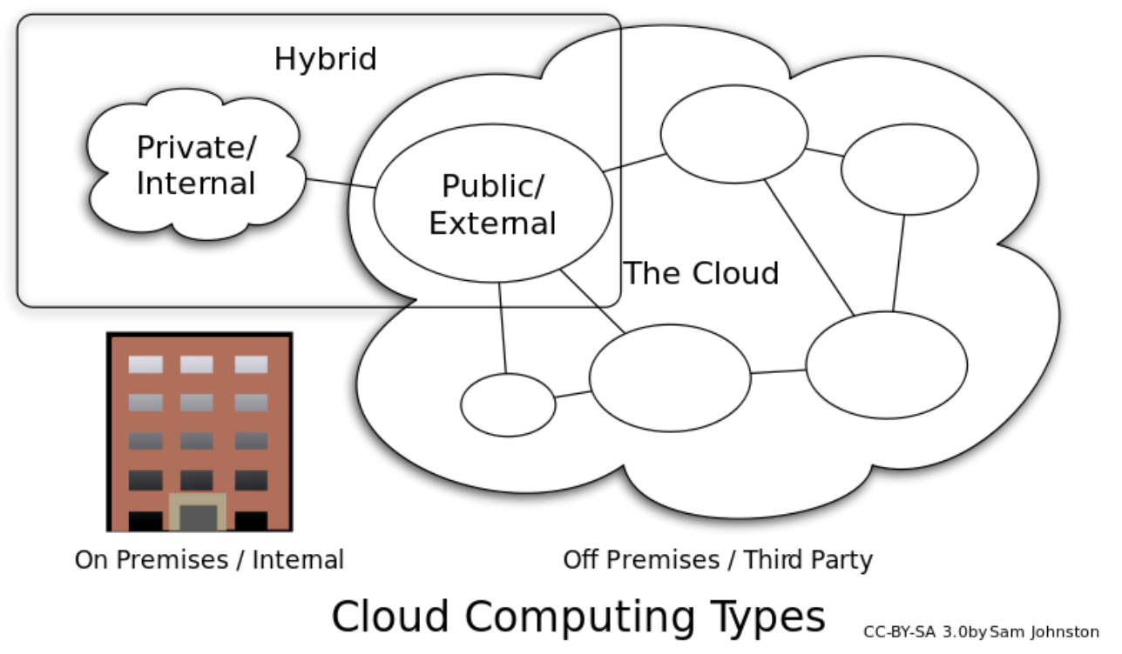
Cloud Types

Slide 11
Outline
Technologies behind cloud computing
Data centers
Virtualization
Programming Frameworks
Challenges and opportunities

Slide 12
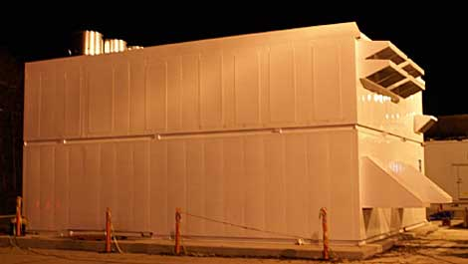
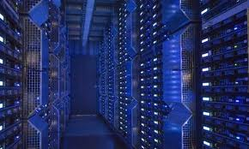
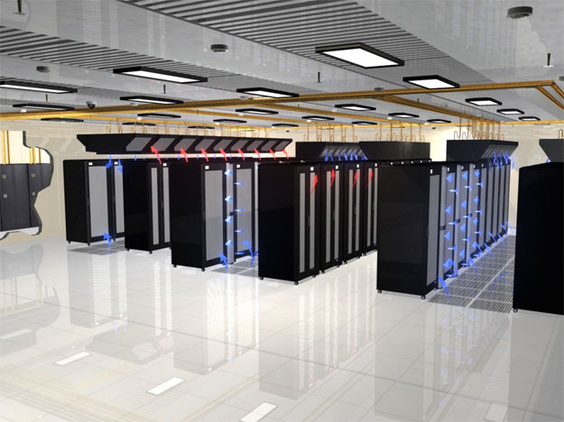
Data Centers
The key infrastructure piece that enables cloud computing
Every large company is building them
Huge amount of work on deciding how to build/design them

Slide 13
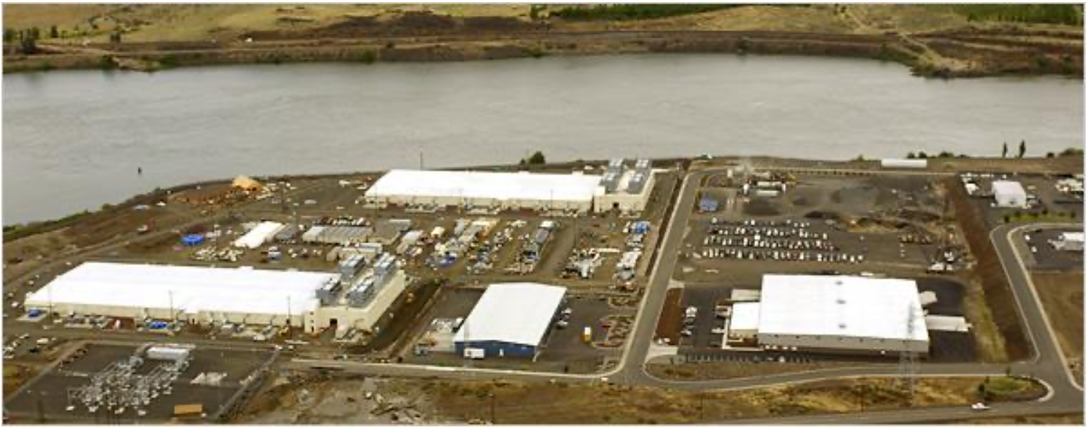
Data Centers

Slide 14
Data Centers
Networking equipment
Very very expensive: server/storage prices dropping fast
Networking frozen in time: vertically integrated ecosystem
Bottleneck – forces workload placement restrictions
Cooling/temperature/energy issues
Appropriate placement of vents, inlets, etc. a key issue
Thermal hotspots often appear and need to worked around
Overall cost of cooling is quite high
So is the cost of running the computing equipment
Both have led to issues in energy-efficient computing
Hard to optimize PUE (Power Usage Effectiveness) in small data centers
🡺 may lead to very large data centers in near future (already happening)
Ideally PUE should be 1, currently numbers are around 1.07-1.22
1.07 is a Facebook data center that does not have A/C
source: James Hamilton Presentation

Slide 15
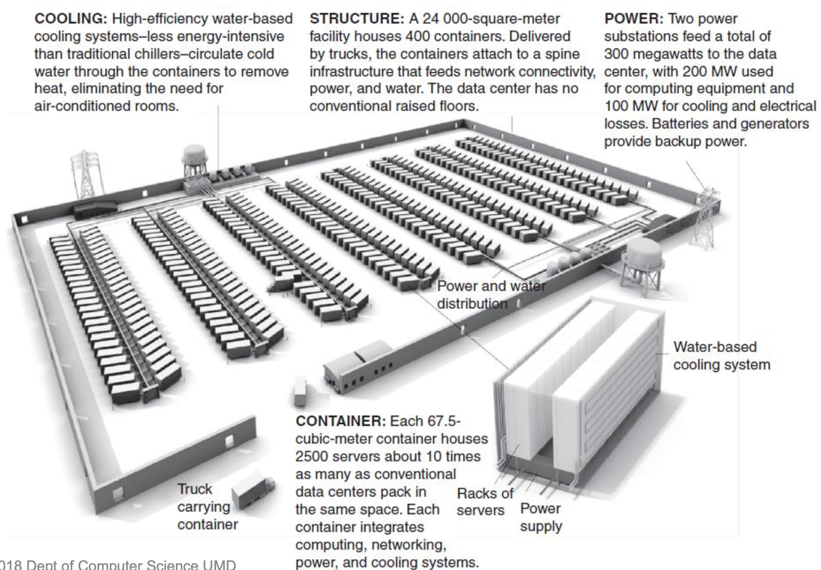
Data Centers
source: James Hamilton Presentation

Slide 16
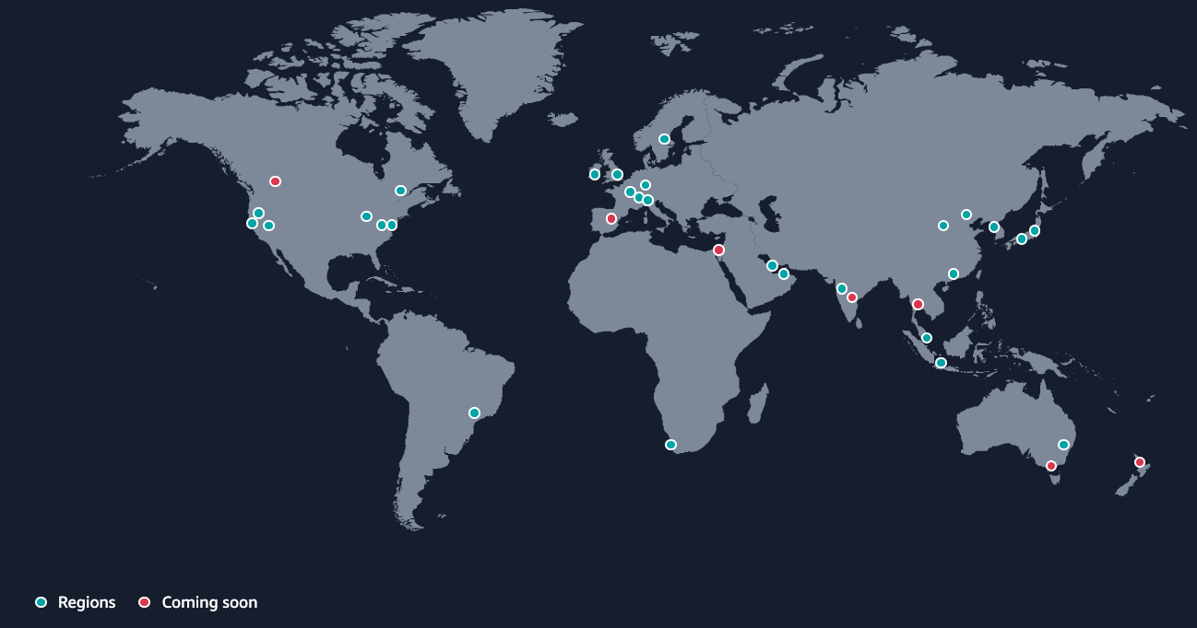
Amazon Web Services
As of 2022, 28 geographical regions

Slide 17
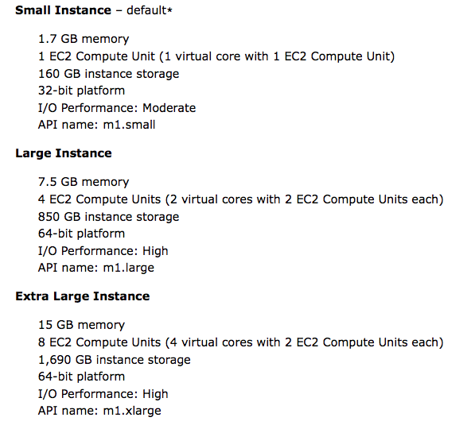
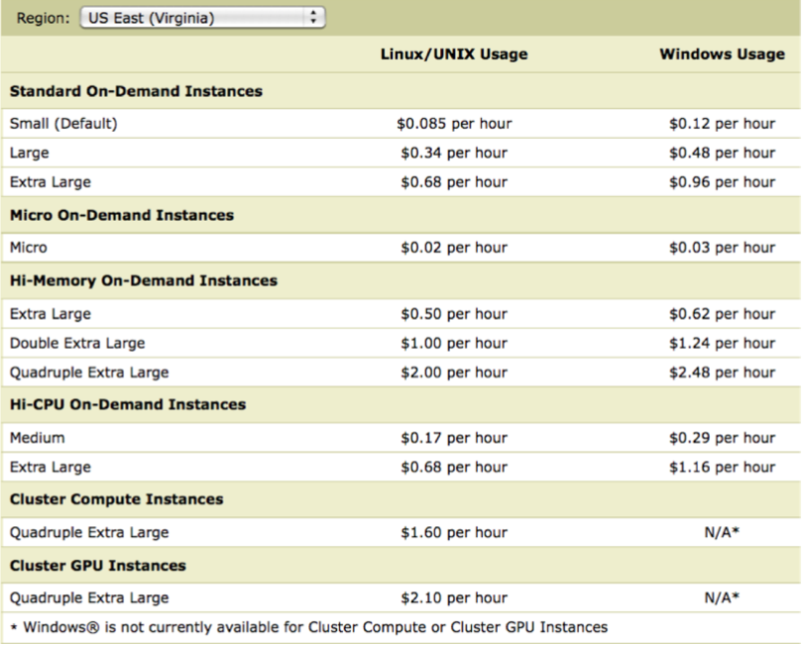
Amazon Web Services (EC2)
Perhaps the most widely used current solution to cloud computing
However alternatives are attractive depending on your needs
Current prices are very low and likely to remain that way
See https://aws.amazon.com/ec2/pricing/on-demand/ for current on-demand pricing

Slide 18
Amazon S3
Amazon storage services (Simple Storage Solution)
Pay for what you use
S3 Storage Types
 | S3 Default | S3 RRS | S3 IA | Glacier
Durability | 99.999999999% | 99.99% | 99.999999999% | 99.999999999%
Availability | 99.99% | 99.99% | 99.9% | 99.99%
Extra Fees * | None | None | Retrieval | Retrieval
Real-Time Access? | Yes | Yes | Yes | No (mins/hours)
Frequently Accessed? | Yes | Yes | No | No

Slide 19
Google App Engine
A very nice solution to build your websites on top of Google infrastructure - PaaS
Allows running a Docker container on Google resources
Also provides managed services, like SQL and NoSQL DBs (like DynamoDB for AWS)
Google Compute Engine - IaaS
Intended to directly compete with Amazon Web Services
Google Docs - SaaS
To share documents in the cloud
E.g., word processor, spreadsheet, presentations

Slide 20
Outline
Technologies behind cloud computing
Data centers
Virtualization
Programming Frameworks
Challenges and Opportunities

Slide 21
Virtualization
Virtual machines (e.g., running Windows inside a Mac, etc.) has been around for a long time
Used to be very slow…
Only recently became efficient enough to make it a key for cloud computing
Basic idea: run virtual machines on your servers and sell time on them
That’s how Amazon EC2, Microsoft Azure, Google Cloud, etc. runs
Many advantages:
Security: virtual machines serves as almost impenetrable boundary
Multi-tenancy: can have multiple VMs on the same server
Efficiency: replace many underpowered machines with fewer high-powered machines

Slide 22
Virtualization
Consumer/desktop VM products include VMWare, Xen, VirtualBox, etc…
Run on top of host OS, with hypervisor/VMM supporting guest OS in virtual environment
Amazon uses Xen running on Redhat machines (may be old information)
They support both Windows and Linux Virtual Machines
Some tricky things to keep in mind:
Harder to reason about performance (if you care)
Identical VMs may deliver somewhat different performance
Much continuing work on the virtualization technology itself
“Bare-metal” versions to improve performance – run hypervisor directly on top of hardware (no hypervisor/VMM)
Good for server farms, like in cloud computing

Slide 23
Desktop Virtualization Architecture
Applications
Applications
Applications
V i r t u a l
Guest OS (Windows)
Guest OS (Linux)
Guest OS (VMware ESX)
Virtual Machine
Virtual Machine
Virtual Machine
Virtual Machine Manager
P h y s i c a l
Host OS
Hardware

Slide 24
Server Virtualization Architecture
Applications
Applications
Applications
Guest OS (Windows)
Guest OS (Linux)
Guest OS (VMware ESX)
V i r t u a l
Virtual Machine
Virtual Machine
Virtual Machine
Virtualization Layer (Hypervisor)
P h y s i c a l
Hardware

Slide 25
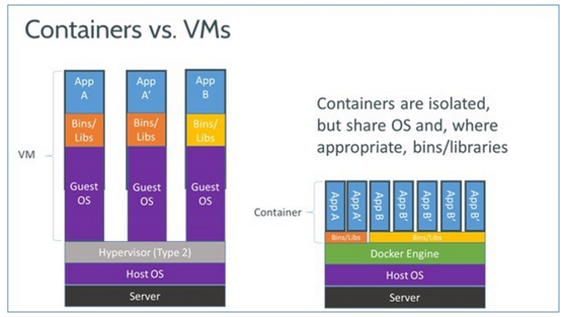
Docker
Hot thing over last few years
Avoid the overheads of virtualization altogether with containers

Slide 26
Outline
Technologies behind cloud computing
Data centers
Virtualization
Programming Frameworks
Challenges and Opportunities

Slide 27
Programming Frameworks
Third key piece emerged from efforts to “scale out”
I.e., distribute work over large numbers of machines (1000’s of machines)
Parallelism has been around for a long time
Both in a single machine and as a cluster of computers
But always been considered very hard to program, especially the distributed kind
Too many things to keep track of:
How to parallelize application
How to distribute the data
How to handle failures
...
Google developed MapReduce and BigTable frameworks and ushered in a new era

Slide 28
MapReduce Framework
Provides a fairly restricted, but still powerful abstraction for programming
Programmers write functions called map and reduce
map programs
inputs: a list of “records” (record defined arbitrarily – could be images, genomes etc…)
output: for each record, produce a set of “(key, value)” pairs
reduce programs
input: a list of “(key, {values})” grouped together from the mapper
output: whatever
Both can do arbitrary computations on the input data as long as the basic structure is followed

Slide 29
Other Programming Frameworks
Many different programming frameworks suitable for different applications
Trying to address different limitations of vanilla Hadoop or other MapReduce-based platforms
Spark:
Based on Resilient Distributed Memory (RDD)
All in-memory, much more efficient; Uses Scala, Python, Java for programming
Hive
SQL-like interface on top of Hadoop, originally from Facebook
Apache HBase
NoSQL column oriented DB – sometimes also called key-value store
Random read/write very large tables (like SQL) on top of Hadoop/HDFS
Modeled after Google BigTable
High-performance Computing (HPC) Systems
More expressive and complex, but a lot more efficient
Apache Storm, Spark Streaming
Focused on handling real-time streaming data
Giraph, GraphLab, GraphX
Graph processing systems

Slide 30
Bigtable/Key-Value Stores
MapReduce and other analytics frameworks are great for batch processing of data
Another use case
Very large-scale web applications that need real-time access with few ms latencies
Google Bigtable
Open source implementation: HBase
Think of it as a very large distributed hash table
Support “put” and “get” operations
With some additional support to deal with versions
Much ongoing work on these systems
Issues with “consistency” and “performance” quite challenging

Slide 31
Outline
Technologies behind cloud computing
Data centers
Virtualization
Programming Frameworks
Challenges and Opportunities

Slide 32
Challenges and Opportunities
Using cloud computing means dependence on others and that could possibly limit flexibility and innovation:
The others are likely become the bigger Internet companies like AWS, Google and IBM, who may monopolise the market
Security is an issue:
Unclear how safe outsourced data is
Unclear when using these services ownership of data is not always clear
There are also issues relating to policy and access:
If your data is stored abroad whose policy do you adhere to?
To deal with government restrictions (e.g., export restrictions), cloud providers will now ensure your data is stored within your country’s borders
What happens if the remote server goes down?
How will you then access files?
There have been cases of users being locked out of accounts and losing access to data
From Dr. Mehmet Gunes, U. Nevada Reno
Notes:
Freedom of Information == FOI

Slide 33
Advantages of Cloud Computing
Lower computer costs:
You do not need a high-powered and high-priced computer to run cloud computing's web-based applications
Since applications run in the cloud, your desktop PC does not need the processing power or hard disk space demanded by traditional desktop software
When you are using web-based applications, your PC can be less expensive, with a smaller hard disk, less memory, more efficient processor …
From Dr. Mehmet Gunes, U. Nevada Reno

Slide 34
Advantages of Cloud Computing
Improved performance:
With few large programs hogging your computer's memory, you will see better performance from your PC
Computers in a cloud computing system boot and run faster because they have fewer programs and processes loaded into memory …
Reduced software costs:
Instead of purchasing expensive software applications, you can get most of what you need for free-ish!
most cloud computing applications today, such as the Google Docs suite
better than paying for similar commercial software
which alone may be justification for switching to cloud applications
From Dr. Mehmet Gunes, U. Nevada Reno

Slide 35
Advantages of Cloud Computing
Instant software updates:
Another advantage to cloud computing is that you are no longer faced with choosing between obsolete software and high upgrade costs
When the application is web-based, updates happen automatically
available the next time you log into the cloud
When you access a web-based application, you get the latest version
without needing to pay for or download an upgrade
With Docker or VMs, can package software to run on any platform that supports virtualization
Improved document format compatibility.
You do not have to worry about the documents you create on your machine being compatible with other users' applications or OSes
There are potentially no format incompatibilities when everyone is sharing documents and applications in the cloud
From Dr. Mehmet Gunes, U. Nevada Reno

Slide 36
Advantages of Cloud Computing
Unlimited storage capacity:
Cloud computing offers virtually limitless storage.
Your computer's current 1 Tbyte hard drive is small compared to the hundreds of Pbytes available in the cloud.
Increased data reliability:
Unlike desktop computing, in which a hard disk can crash and destroy all your valuable data, a computer crashing in the cloud should not affect the storage of your data.
if your personal computer crashes, all your data is still out there in the cloud, still accessible
In a world where few individual users back up their data on a regular basis, cloud computing is a data-safe computing platform
From Dr. Mehmet Gunes, U. Nevada Reno

Slide 37
Advantages of Cloud Computing
Universal document access:
That is not a problem with cloud computing, because you do not take your documents with you.
Instead, they stay in the cloud, and you can access them whenever you have a computer and an Internet connection
Documents are instantly available from wherever you are
Latest version availability:
When you edit a document at home, that edited version is what you see when you access the document at work.
The cloud always hosts the latest version of your documents
as long as you are connected, you are not in danger of having an outdated version
From Dr. Mehmet Gunes, U. Nevada Reno

Slide 38
Advantages of Cloud Computing
Easier group collaboration:
Sharing documents leads directly to better collaboration.
Many users do this as it is an important advantages of cloud computing
multiple users can collaborate easily on documents and projects
Built-in revision control system, sort of
Device independence.
You are no longer tethered to a single computer or network.
Changes to computers, applications and documents follow you through the cloud.
Move to another (maybe portable) device, and your applications and documents are still available.
From Dr. Mehmet Gunes, U. Nevada Reno

Slide 39
Disadvantages of Cloud Computing
Requires a constant Internet connection:
Cloud computing is impossible if you cannot connect to the Internet.
Since you use the Internet to connect to both your applications and documents, if you do not have an Internet connection you cannot access anything, even your own documents.
A dead Internet connection means no work and in areas where Internet connections are few or inherently unreliable, this could be a deal-breaker.
From Dr. Mehmet Gunes, U. Nevada Reno

Slide 40
Disadvantages of Cloud Computing
Does not work well with low-speed connections:
Similarly, a low-speed Internet connection, such as that found with dial-up services, makes cloud computing painful at best and often impossible
Web-based applications require a lot of bandwidth to download, as do large documents
Features might be limited:
This situation has been changing, but many web-based applications simply are not as full-featured as their desktop-based applications
For example, you can still do a lot more with Microsoft PowerPoint than with Google Presentation's web-based offering
From Dr. Mehmet Gunes, U. Nevada Reno

Slide 41
Disadvantages of Cloud Computing
Can be slow:
Even with a fast connection, web-based applications can sometimes be slower than accessing a similar software program on your desktop PC
Everything about the program, from the interface to the current document, has to be sent back and forth from your computer to the computers in the cloud
If the cloud servers happen to be backed up at that moment, or if the Internet is having a slow day, you would not get the instantaneous access you might expect from desktop applications
From Dr. Mehmet Gunes, U. Nevada Reno

Slide 42
Disadvantages of Cloud Computing
Stored data might not be secure:
With cloud computing, all your data is stored on the cloud
How secure is the cloud?
Can unauthorized users gain access to your confidential data?
Stored data can be lost:
Theoretically, data stored in the cloud is safe, replicated across multiple machines
But on the off chance that your data goes missing, you have no physical or local backup.
Put simply, relying on the cloud puts you at risk if the cloud lets you down
From Dr. Mehmet Gunes, U. Nevada Reno

Slide 43
Disadvantages of Cloud Computing
HPC Systems:
Not clear that you can run compute-intensive HPC applications that use MPI or OpenMP
This may be changing, but issue is still low-latency, high-bandwidth interconnect, and more recently, accelerators
Scheduling is important with this type of application
as you want all the VMs to be co-located to minimize communication latency
General Concerns:
Each cloud systems uses different protocols and different APIs
may not be possible to run applications across different cloud-based systems
Amazon has created its own DB system (not SQL 92), and workflow system (many popular workflow systems out there)
so your existing applications have to be adapted to execute on these platforms.
From Dr. Mehmet Gunes, U. Nevada Reno

Slide 44
In Summary
Three key pieces of cloud computing
Data centers
Increasingly growing in numbers
Many challenges in building them, maintaining them etc..
Virtualization
Programming frameworks
Simplest (to explain): just use the virtual machines directly
But much harder to manage
Using Hadoop or HBase or … simplifies the programming quite a bit
But Hadoop is open source, and managing Hadoop installations not much easier
Still many ongoing technical challenges

